Slide 1
M/EEG Statistical Analysis & Source Localization
2017-2018
Freddy Chiu
Expert: Professor Gareth barnes

Slide 2
Review: What have we done with ERP?
Stage 1
EEG Signal Capture
Stage 2
Pre-processing
Stage 3
Statistical Analysis

Slide 3
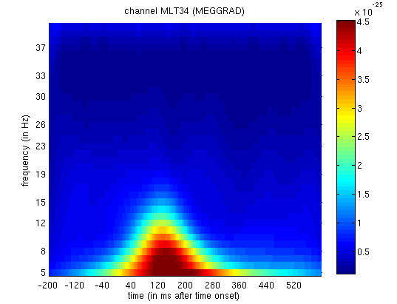
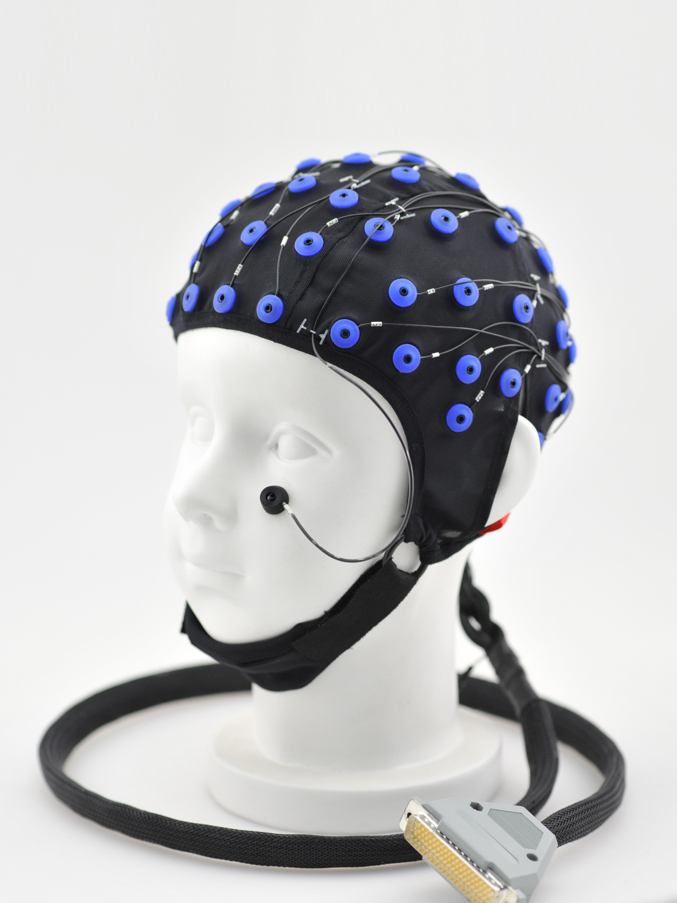
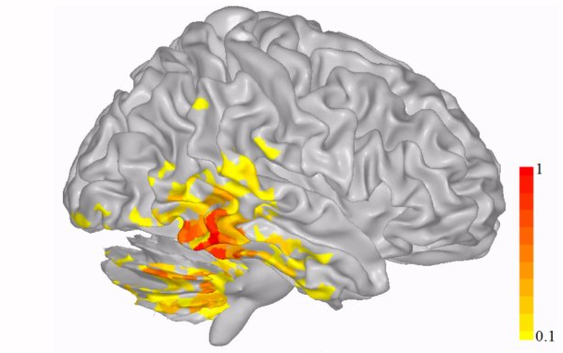
Statistical Analysis in M/EEG
Sensor-space Analysis
Source-space Analysis
Kilner et al., 2005, Nsci Letters

Slide 4
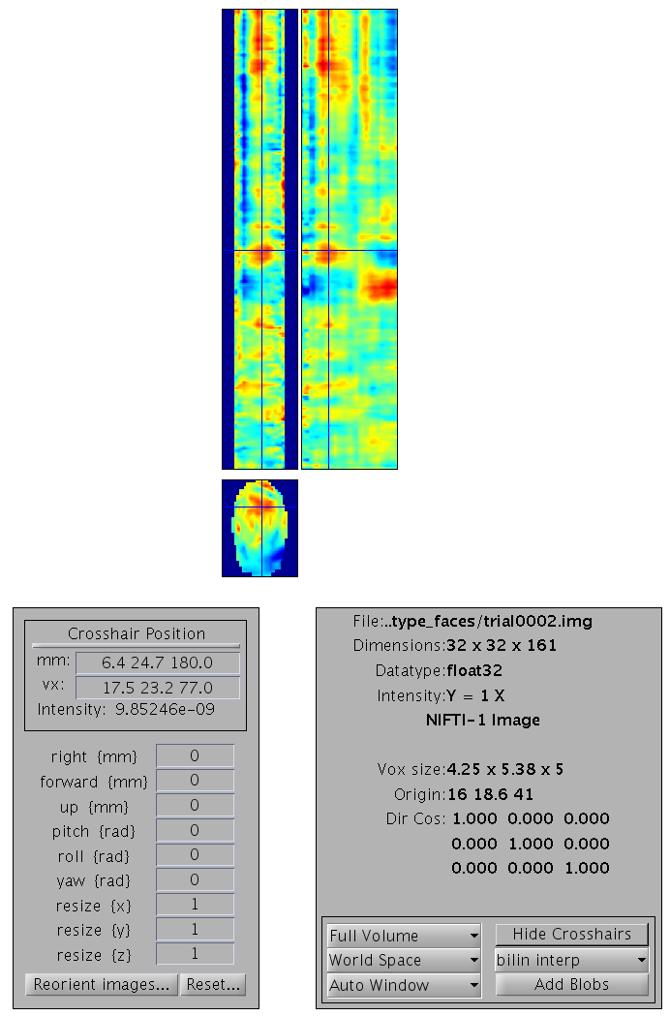
Sensor-space Analysis
Time-frequency space study
  Focus on frequency distribution over time
  Single channel analysis
Sensor-time space study (3D Topography – time image)
  2D Topographic projection across the scalp over time
  All channels analysis
Notes:
N400 is the negative-going peak appeared at around 400 milliseconds post-stimulus onset
Sensor

Slide 5
Extra: Sensor-time Space on MEG
Usually, the positions of all sensors/electrodes should be adjusted by the head-size difference.
Problem: Fixed sensors position in MEG
Solution: Virtual Transformation to the position

Slide 6
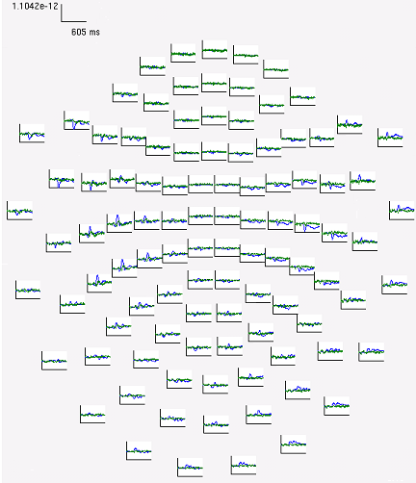
Multiple comparison problem
How many sets of EEG data will be collected for a 30 minutes recording?
Number of electrodes? 10-256 sites
Time Window? Hundred milliseconds
Experimental Design? Event-related design

Slide 7
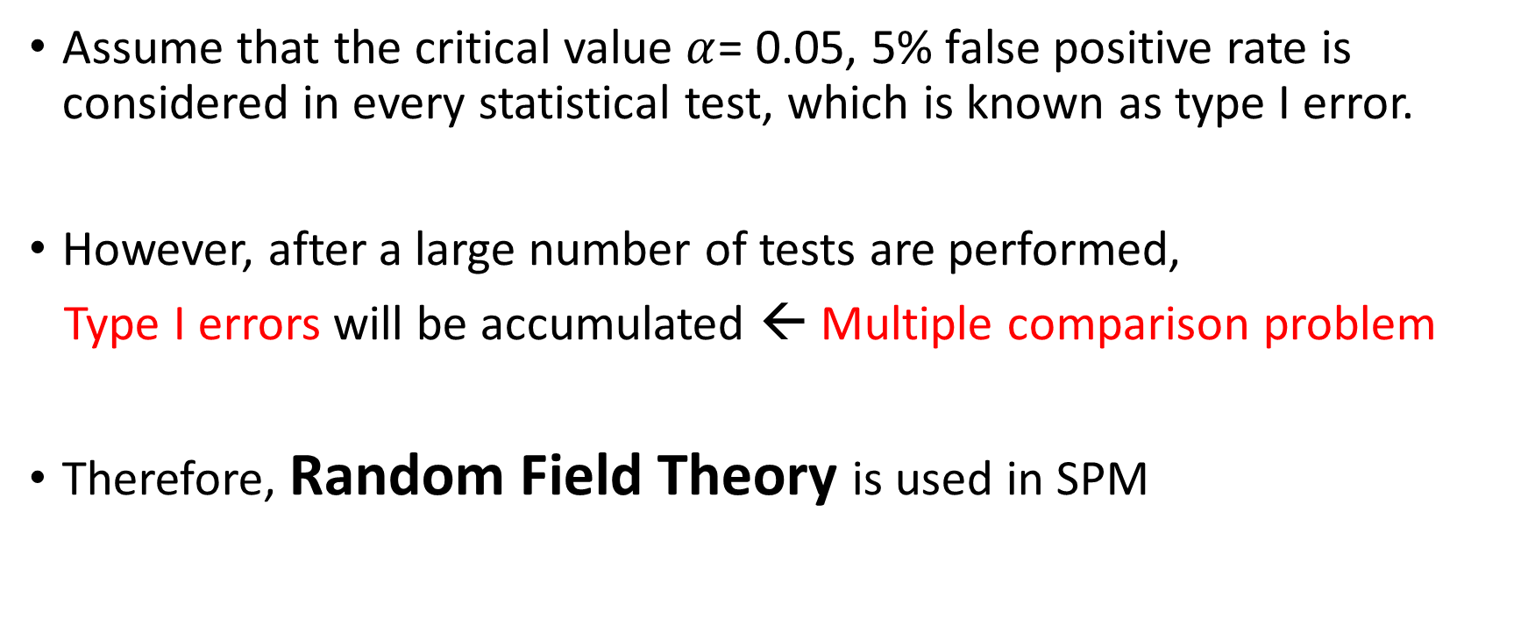
Multiple comparison problem
Assume that the critical value $α$= 0.05, 5% false positive rate is considered in every statistical test, which is known as type I error.
However, after a large number of tests are performed,
Type I errors will be accumulated ← Multiple comparison problem
Therefore, Random Field Theory is used in SPM

Slide 8
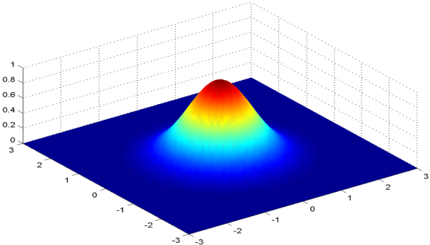
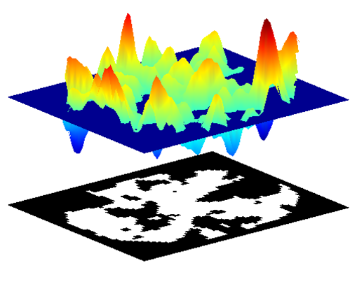
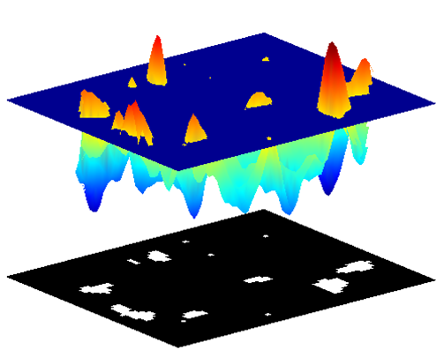
Topological Inference
Random Field Theory (RFT)
Step 1: Smoothing by the weighted average of all images
Step 2: Calculate Euler characteristic with setting up a height threshold
Multi-dimensional convolution with Gaussian kernel

Slide 9
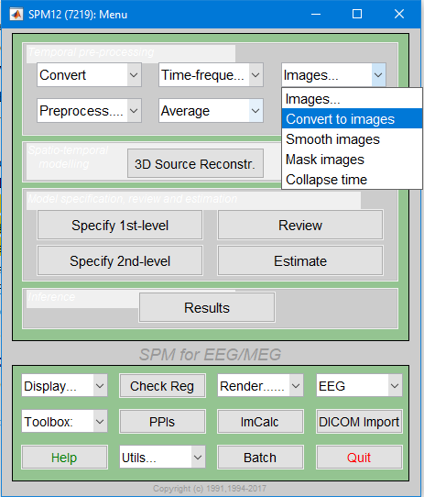
Sensor-space Analysis in SPM (I)
Convert to 3D scalp x time Image
(NifTI files)

Slide 10
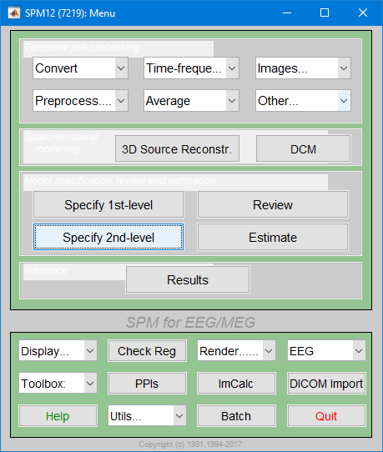
Sensor-space Analysis in SPM (II)
“Specify 2nd Level”
Perform paired/unpaired t-tests over subjects
If region of interest is priory considered, Small Volume Correction (SVC) will be applied
  Reduce FEW
Then “Estimate”
Notes:
Small Volume Correction can reduce the number of voxels and control the FWE

Slide 11
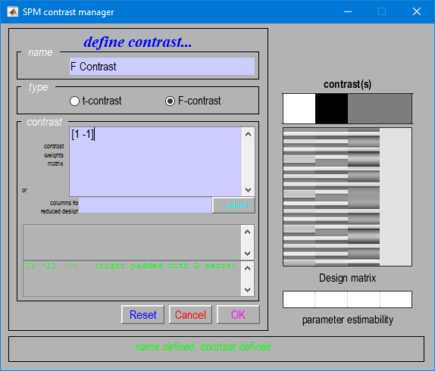
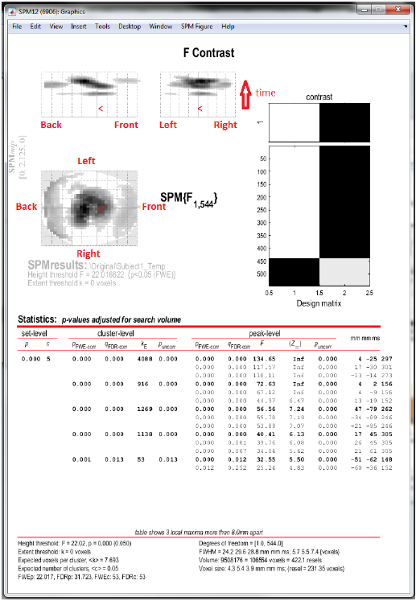
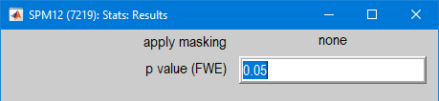
Sensor-space Analysis in SPM (III)
“Result”
Perform F-contrast
Set the desired p-value
(FWE)
Statistical Graphics
  Location of Maxima
Notes:
Small Volume Correction can reduce the number of voxels and control the FWE

Slide 12
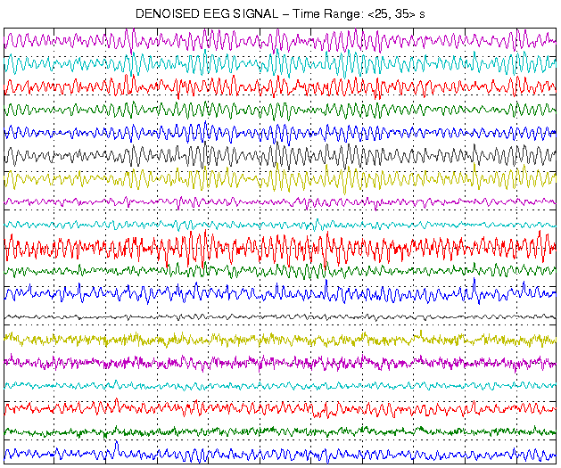
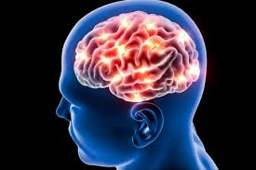
Source-space Analysis
Forward Problem
Cognitive Mechanism
Inverse Problem
Brain Activity
Notes:
Forward Problem: Cognitive Process to Brain Activity
Inverse Problem: Brain Activity to Cognitive Process

Slide 13
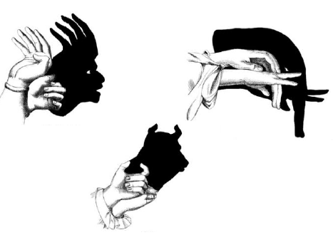
Analogy (Forward Model)

Slide 14
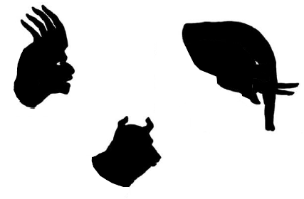
Analogy (Inverse Model)
Notes:
Don’t remember what are the presented hand posture in the previous slide
But we can still make up our own way to repeat these pattern

Slide 15
Inverse Problem
Also known as ill-posed problem
Too many possible solutions to explain measured current distributions
Source-Space Analysis

Slide 16
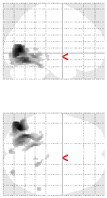
Source-space Analysis
How to perform Source reconstruction/localization?
Estimate the current distribution across the cortex
Input data to 3D image in MNI coordination
Smooth and analyse by GLM
EEG

Slide 17
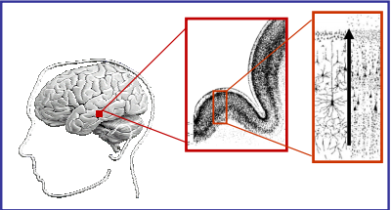
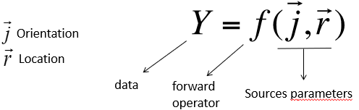
Equivalent Current Dipole (ECD)
Assume that there are a small number of dipoles
Estimate the magnitude and orientation of dipole
Dipole
Source
Notes:
http://www.fil.ion.ucl.ac.uk/~wpenny/talks/msc-meeg-sources.pdf

Slide 18
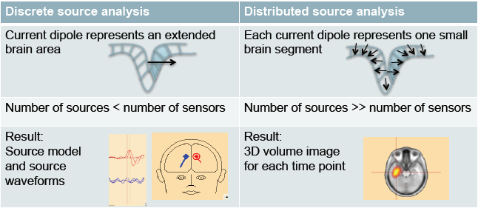
From ECD to Distributed Dipoles

Slide 19
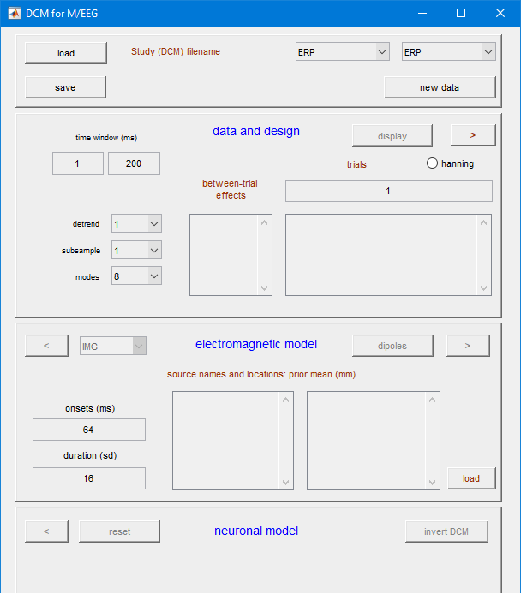
Dynamic Causal Modelling (DCM)
A network model consisting of several sources
Investigate the modulation of connections by task
Very Useful model towards inverse problem

Slide 20
Reference
Litvak, V., Mattout, J., Kiebel, S., Phillips, C., Henson, R., Kilner, J., ... & Penny, W. (2011). EEG and MEG data analysis in SPM8. Computational intelligence and neuroscience, 2011.
MfD presentations from previous years
Online Video Course by Jason Taylor:
  http://www.fil.ion.ucl.ac.uk/spm/course/video/#MEEG_Stats
SPM manual: http://www.fil.ion.ucl.ac.uk/spm/data/face_rep/
Lecture Notes from PSYCGC11 Neuroimaging by Dr Leun Otten
Professor Gareth Barnes’s advice

